Slide 1
DOOR BELL SECURITY SYSTEM
SUYASH SOUMYA 1MS12CS109
ABHISHEK KUMAR SINGH 1MS12CS003
ASHWIJ.S 1MS11CS152

Slide 2
PROJECT GOALS
To implement a home security system using raspberry pi
To help the owner to determine how many times and when the specific door bell has been pressed
Helps manage and makes his/her life easier
Also have ease of control as continuous notifications are sent to owner.
Also we seek to maintain a database on a cloud service provider

Slide 3
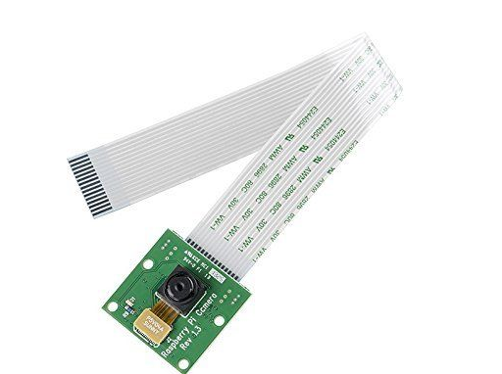
SENSOR DESCRIPTIONS
Raspberry pi camera module

Slide 4
The Raspberry Pi camera module can be used to take high-definition video, as well as stills photographs.
There are lots of examples online of people using it for time-lapse, slow-motion and other video cleverness. You can also use the libraries we bundle with the camera to createeffects.

Slide 5
module has a five megapixel fixed-focus camera that supports 1080p30, 720p60 and VGA90 video modes, as well as stills capture.
It attaches via a 15cm ribbon cable to the CSI port on the Raspberry Pi.
The camera works with all models of Raspberry Pi 1 and 2. It can be accessed through the MMAL and V4L APIs.

Slide 6
Description about the SRS
Functional requirement 1.1
Register on Twitter and Ubidots cloud:
A user should be able to register onto the twitter account which he also downloads onto his phone from the application store. He will use this to view the entry logs of his guests.
Functional requirement 1.2
Notify users of new entries:
When a new entry is produced when a person rings the door bell, that information should be quickly uploaded onto twitter and also a notification must be sent to the mobile phone of user.
Functional requirement 1.3
Users should be able to edit, delete and maintain his entries. Multiple photographs of the same entry must be avoided so as to avoid confusion.
Functional requirement 1.4
Ubidots cloud database must store complete record which also acts like a backup which iff possible also sends notifications to users upon new entries.

Slide 7
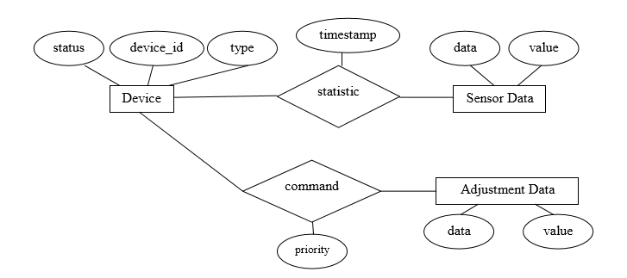
Class Diagrams and Sequence Diagrams

Slide 8
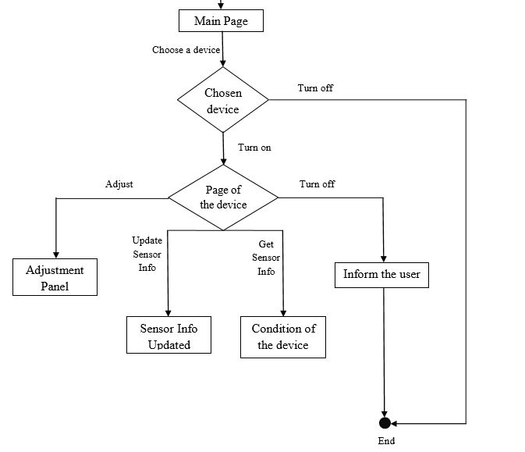

Slide 9
Process Model
Iterative and Incremental development is any combination of both iterative design or iterative method and incremental build model for software development. The combination is of long standing and has been widely suggested for large development efforts.

Slide 10
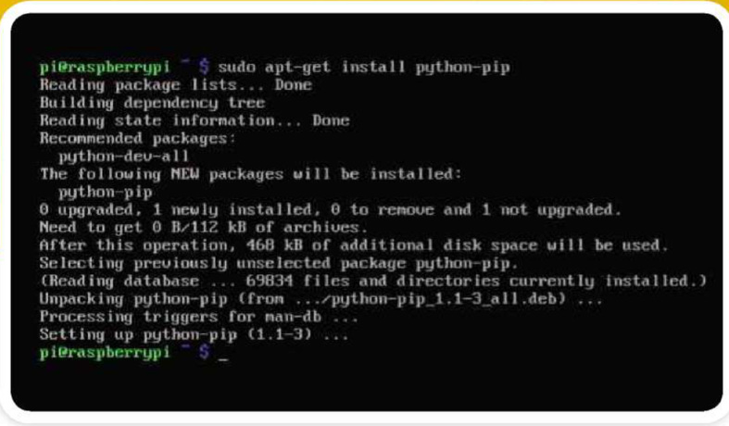
Implementation details

Slide 11
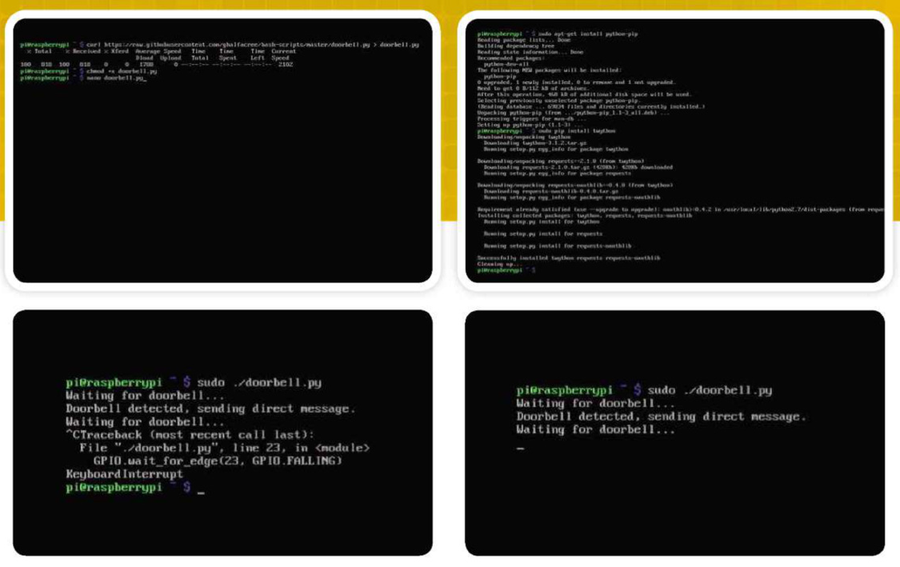
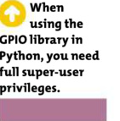

Slide 12
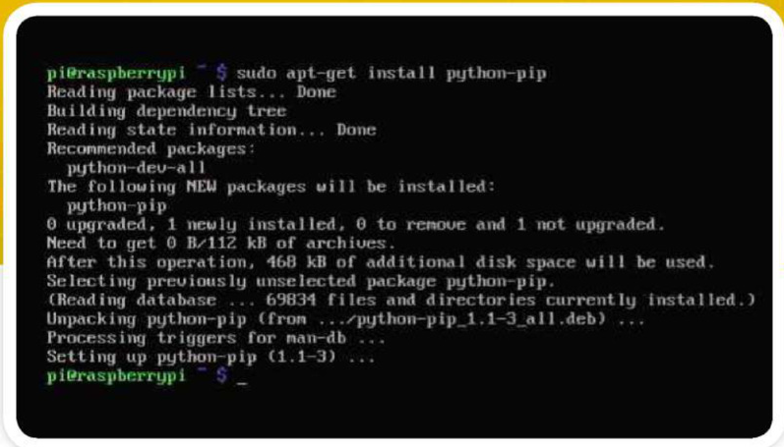
Results

Slide 13
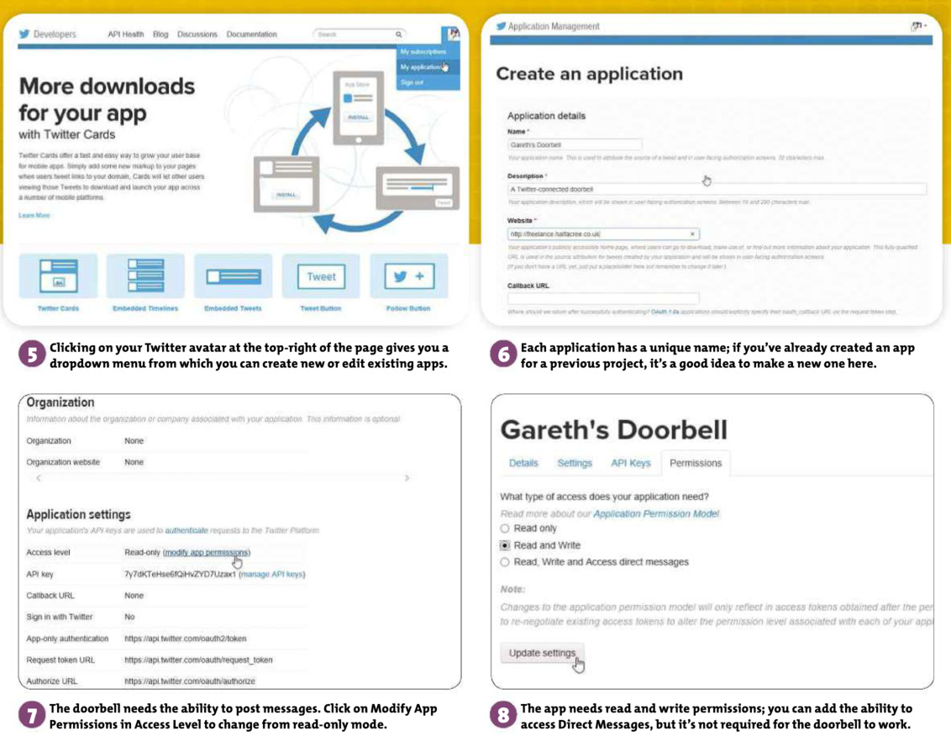

Slide 14
Software System Attributes
Reliability
When user wants to call the system over a given period of time, the system should correctly deliver services as expected by the user. The reliability of the system shall be good if it delivers services as specified. Otherwise, reliability is bad and it shall produce unexpected output.

Slide 15
Availability
When the system has any request at any given time, system should be available, it should be up and running and able to deliver useful service at this time. The availability of the system shall be good if it delivers services when it is requested. Otherwise, if requests are not responded at any given time then it implies bad availability.
The average system availability (not considering network failing). Measurements obtained from 1000 hours of usage during testing

Slide 16
Security
The system should resist accidental or deliberate intrusions, when users operate on the system. If the system should not resist accidental or deliberate intrusions, then important data – such as credit card number, id number, username, etc. – which belongs to user, shall be stolen by hacker. Thus, security of the system shall be low and trust of users shall be ruined. So, security of the system is very important for users.

Slide 17
Portability
The application should be portable with iOS and Android. The adaptable platform for the application to run on.

Slide 18
Maintainability
When the system is used, new requirements may emerge. When these requirements are emerged, the system should be changeable to accommodate these requirements for maintaining the usefulness of the system. If the system is not maintainable, then the system cannot be modified for new requirements.

Slide 19
Performance Requirements
The resulting Doorbell System must perform both in home appliances and office and other business establishments.
Also the sensors should be having the ability of compatibility more than the ones in the market.
Additionally a more general communication protocol and wireless controller hardware should be used to make the system perform on much more devices.
The system should access data in reasonable time.

Slide 20
Database Requirements
The Database maintained over the cloud must be secure and data should be easily available, easy to maintain and update. Also the size of the database must meet the requirements. Database must be ready for access from mobile devices as well as remote devices.
In our project, there are two databases. One of them keeps user information. Information is user name, surname, country, city, password, e-mail address and address.
It is necessary to keeping users information in the database.
This stored on cloud using Ubidots

Slide 21
Design Requirements
The reporting of the project should be in IEEE standards and its diagrams should be drawn in UML standards. The interface between the system components should be well described to make the user control easier. As an environment constraint, master controller software should be developed on Linux system. Moreover, there is another constraint on wireless communication protocol. In this system, wireless protocol should be used to make the devices communicate. The transmitted information between the devices should be carried in encrypted form, as a security constraint.

Slide 22
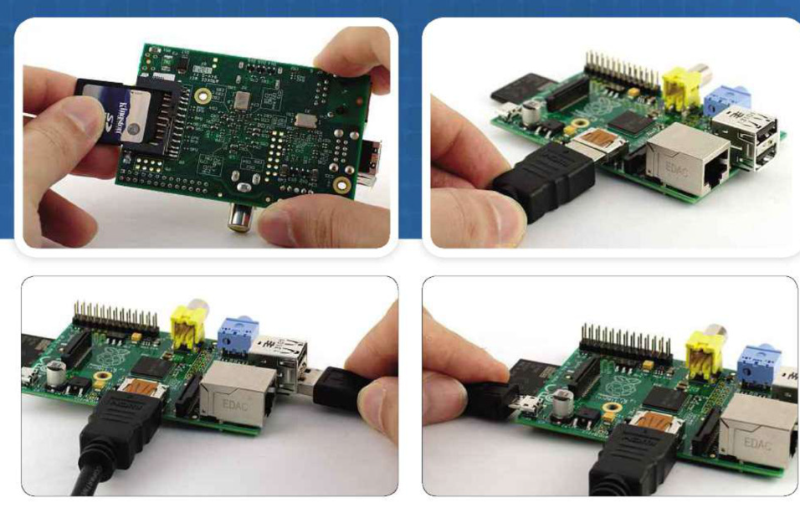
Attaching

Slide 23
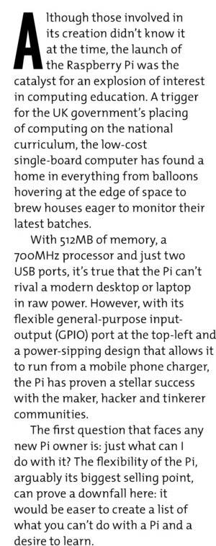
Conclusion and Future work

